Slide 1
EECS 370
Lab 5: Digital Logic

Slide 2
Upcoming Assignments
P2a due Thursday Oct 2
Midterm Exam Thursday Oct 9 6-8 PM

Slide 3
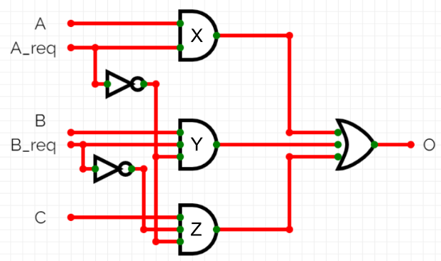
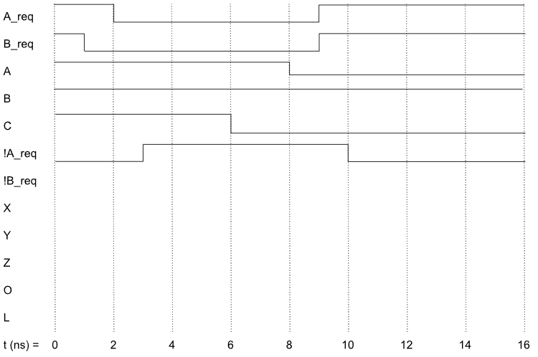
Problem 1: Circuit Delay
Fill in the timing diagram for the logical circuit

Slide 4
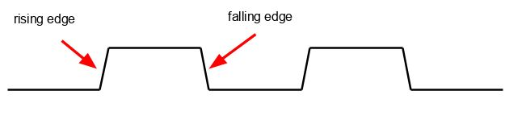
Clocks
Periodic pulse. Switches from 0 to 1 periodically (equal intervals)
We can determine this interval, but it stays constant once set.
This will be useful when we do operations with different propagation delays

Slide 5
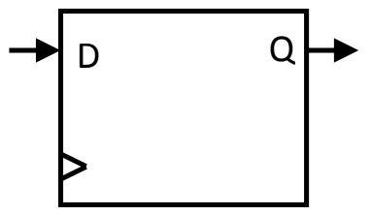
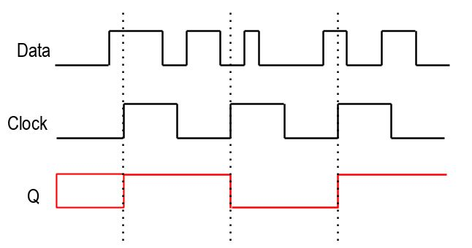
D-Flip Flop
2 signals being fed in: the Data and the Clock
State of the output changes while clock is changing state
In this class, we'll always update Q on the rising-edge of the clock (when it goes from 0 to 1)

Slide 6
Finite State Machines
Finite State Machines (FSMs) describe the intended behavior of a sequential circuit.
An FSM consists of:
Inputs & Outputs
Set of States
Set of Transitions
S_0
out = 0
B’
S_2
out = 0
B’
B’
B’
START
B
B
S_1
out = 1
S_3
out = 1
B
B

Slide 7
Finite State Machines
A Moore machine has an output function which only requires the current state as an input.
  F(S) → O
A Mealy machine has an output function which requires both the current state and current input as input.
  F(S, I) → O
Moore or Mealy?
S_0
out = 0
B’
S_2
out = 0
B’
B’
B’
START
B
B
S_1
out = 1
S_3
out = 1
B
B

Slide 8
Finite State Machines
A Moore machine has an output function which only requires the current state as an input.
  F(S) → O
A Mealy machine has an output function which requires both the current state and current input as input.
  F(S, I) → O
Moore or Mealy?
S_0
out = 0
B’
S_2
out = 0
B’
B’
B’
START
B
B
S_1
out = 1
S_3
out = 1
B
B

Slide 9
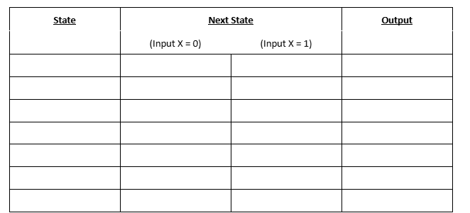
Problem 2: FSMs
Design a Moore machine where the output Y goes high (=1) when the last six bits of the input X were 100101
Fill in the table:

Slide 10
Problem 3
Expose buggy instructor solutions for P2a
For this problem, your group will be submitting (to autograder.io) assembly code AND its correct output object file when run through the project 2a assembler.
Once you have written test cases that expose the bugs, you must write the corresponding correct object file output and submit it to the autograder for full credit.
In addition to the constraints listed in the project, each LC2K program you write must be limited to 4 lines or fewer.
No test cases should cause errors on a correct assembler.
Each submission will be limited to 4 test cases, but fewer may be needed.
Each output file name must be the same as the assembly, with the extension changed to .obj.

Slide 11
Extra Slides

Slide 12
What to cover?
Logic Gates Problems 1, 2 Slides 13
Muxes, Decoders, ALU Problem 3 Slides 19-
Propagation Delay Problem 4 Slides 29
Timing Diagrams Problem 5 Slides 32, 37
Latches & Flip Flops Problem 5 Slides 34
Finite State Machines Problems 6, 7 Slides 42

Slide 13
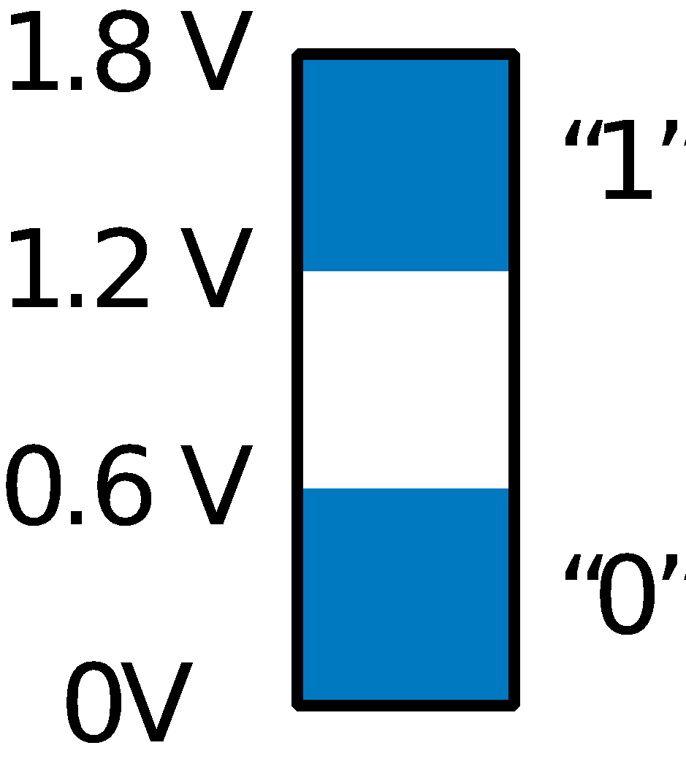
Logic Gates
N
O
T
OR
AND
Symbol
x
F
x
x
y
F
y
F
x
F
x
y
F
x
y
F
Logic Gates implement Boolean operators using transistors
  Logic gates form the basis of computers.
  Implemented under the hood with transistors
Truth table
0
1
0
0
0
0
0
0
1
0
0
1
1
0
1
0
1
0
1
1
0
0
1
1
1
1
1
1
1
0
0
y
y
x
Transistor
circuit
x
F
x
F
F
y
x
y
0
x
1
1
1 and 0 each actually correspond to a voltage range
Notes:
‹#›

Slide 14
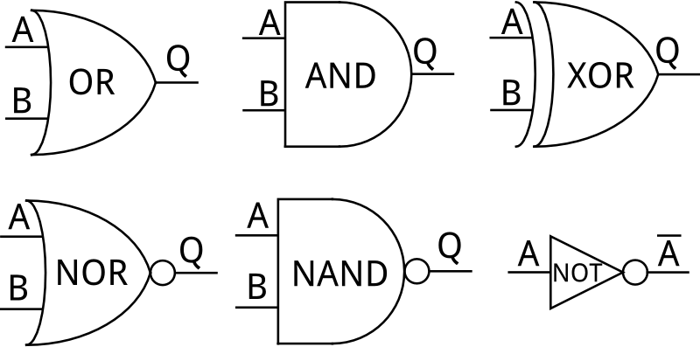
Common Logic Gates
In combinational logic, output is determined solely by the inputs
On the right are the 6 most common logic gates
NOR and NAND are both functionally complete -- any boolean function can be constructed from NANDs or NORs

Slide 15
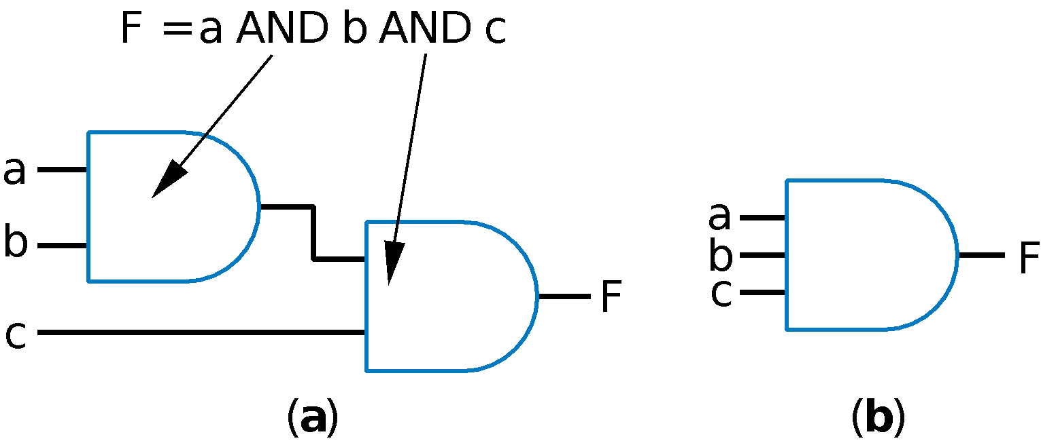
Using gates with more than 2 inputs
Can think of as AND(a,b,c)

Slide 16
Problem 1: Gates to Logical Equation
Convert the following logic gates to a logic equation.
(Hint: Start from the output, work back to the inputs.)
a
F = a && !(b || !c) //C/C++ Logical Form
b
F
c

Slide 17
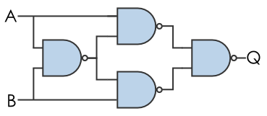
Problem 2: Build another Gate out of NAND Gates
Given the below construction from 4 functionally complete NAND gates, what other elementary gate is represented?
NAND Gate Truth Table
A | B | Q
0 | 0 | 1
0 | 1 | 1
1 | 0 | 1
1 | 1 | 0

Slide 18
Problem 2: Build another Gate out of NAND Gates
Given the below construction from 4 functionally complete NAND gates, what other elementary gate is represented?
A ^ B = (A & ~B) | (~A & B) Definition
= ~~((A & ~B) | (~A & B)) Double Negation
= ~(~(A & ~B) & ~(~A & B)) DeMorgan’s Law
= ~(~(A & ~(A & B)) & ~(~(A & B) & B)) Absorption 2x
~(~(A & ~(A & B)) & ~(~(A & B) & B))
Final Gate Truth Table
A | B | Q
0 | 0 | 0
0 | 1 | 1
1 | 0 | 1
1 | 1 | 0
Notes:
A & ~B = (A & ~B) | 0
= (A & ~B) | (A ^ ~A)
= A & (~B | ~A)
= A & ~(B & A)

Slide 19
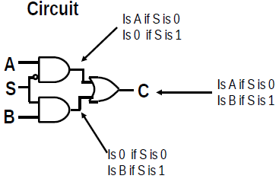
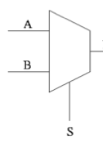
Multiplexers (MUX) Allow the Selection of Inputs
MUXs select one of N multiple inputs, and are controlled by log₂(N) bits.
We assume that a selection of all 0s selects the top-most input
C/C++ Form: C = S ? B : A

Slide 20
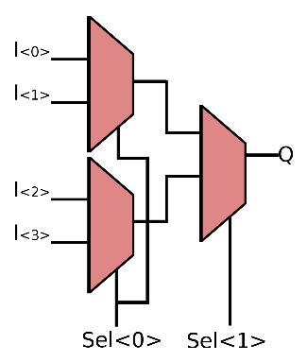
4 Bit Muxes
00
MUX
01
10
Out
11

Slide 21
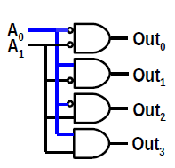
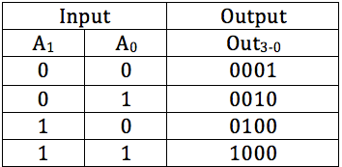
Decoders Turn n-digit Bf mbers to 2^{n} Outputs
Decoders can be used to select one output from a specific input
Uses “one-hot” encoding, where only one line can be enabled at once

Slide 22
8-entry 4-bit ROM
3x8
Decoder
address
0
110
A₀
A₁
A₂
A diode only allows current to flow in one direction.
It prevents a ‘1’ from propagating to other lines.
3
7
D₀
D₁
D₂
D₃
1
0
0
1
data

Slide 23
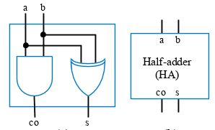
Adding two 1-bit numbers together
Circuit Adds A + B, outputs Sum and Carry
Inputs |  | Outputs
a | b | c | s
0 | 0 | 0 | 0
0 | 1 | 0 | 1
1 | 0 | 0 | 1
1 | 1 | 1 | 0

Slide 24
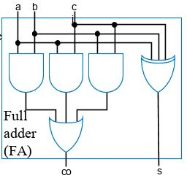
Adding two 1-bit numbers together
To use the carry in the next bit, we use a Full Adder
The previous was a Half Adder
Full Adder: Adds A + B + Carry, outputs Sum and Carry
When Carry In is 0, the Full Adder behaves like a Half
Inputs |  |  | Outputs
a | b | c_{in} | c_{out} | s
0 | 0 | 0 | 0 | 0
0 | 1 | 0 | 0 | 1
1 | 0 | 0 | 0 | 1
1 | 1 | 0 | 1 | 0
0 | 0 | 1 | 0 | 1
0 | 1 | 1 | 1 | 0
1 | 0 | 1 | 1 | 0
1 | 1 | 1 | 1 | 1

Slide 25
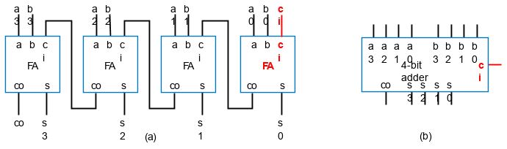
Ripple Carry Adder
We can combine FAs together to create an adder that performs addition like we do by hand.

Slide 26
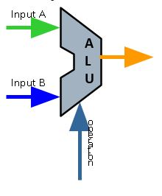
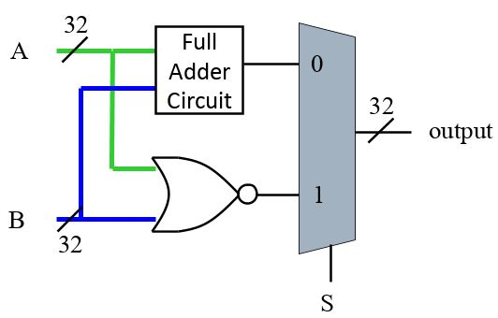
Arithmetic Logical Unit (ALU)
The “heart” of the computer processor
For LC2K: Can execute either an addition of two (32 bit) numbers, or a noring
MUX Control Scheme: 0 - Addition; 1 - Nor

Slide 27
Equality Checking
Our ALU always checks for equality.
This can be done with bitwise XNOR, then AND on all bits.
Also can be done by subtracting A-B and NOR on all bits.
eq?
A | B | Q
0 | 0 | 1
0 | 1 | 0
1 | 0 | 0
1 | 1 | 1

Slide 28
Problem 3: Short Answer Questions
If we have an n-input MUX (e.g. A₁, A₂, …, A_{n}) how many control bits do we need?
True or False: The number of select lines in an 8x1 MUX is equal to the number of input lines in a 3x8 Decoder
⌈log₂(n)⌉
True

Slide 29
Propagation Delay Influences How Circuits Are Built
Physical changes in voltage levels take time to reach the other end
With circuits consisting of multiple paths, have to wait on all paths
2 ns
Consider the propagation delay for our XOR gate if each NAND gate takes 2ns
We have a 6ns delay
2 ns
2 ns
2 ns

Slide 30
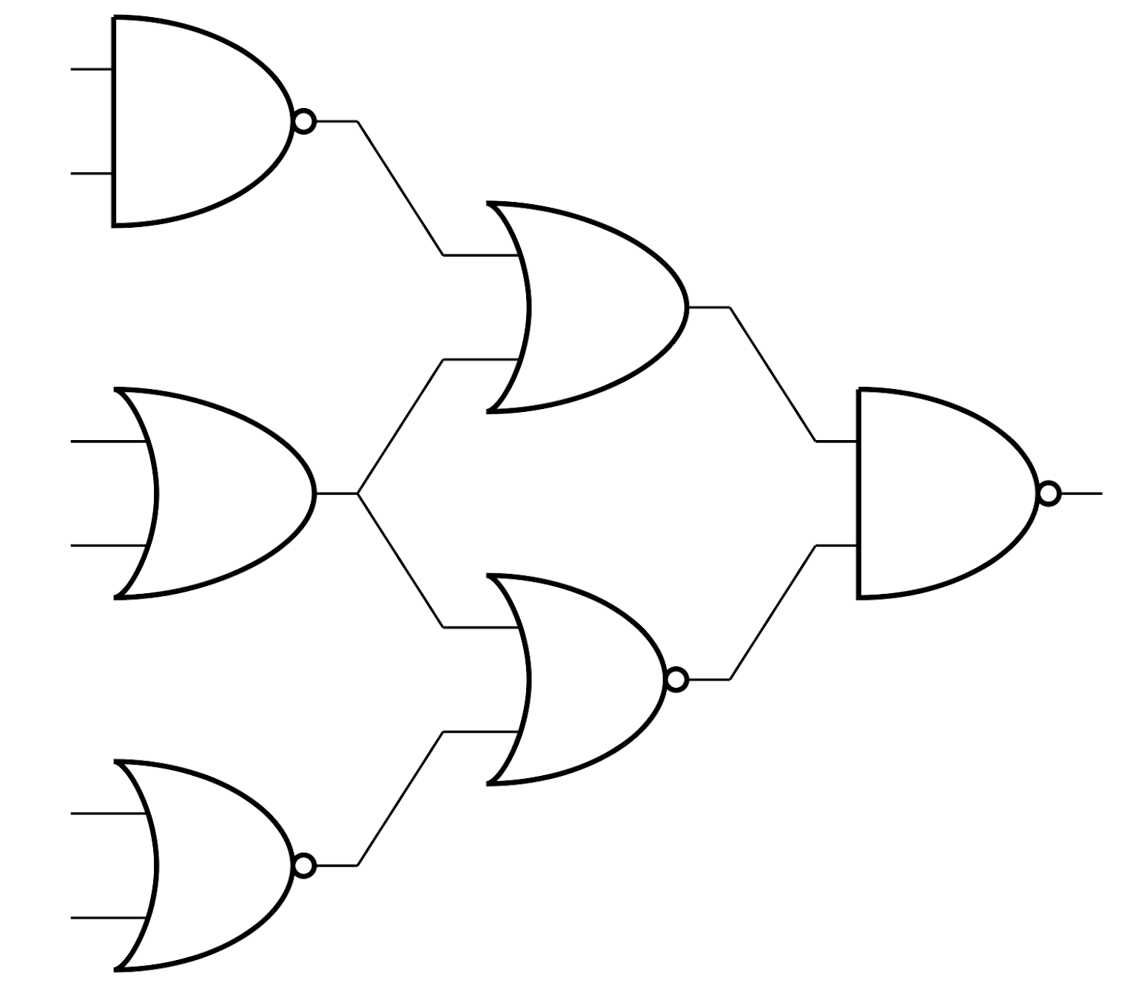
Problem 4: Calculate the Propagation Delay
Calculate the propagation delay in the following circuit, assuming the delays are 2ns for NAND, 4ns for NOR, and 5ns for OR
2
5
Longest Path:
5ns + 5ns + 2ns = 12ns
5
2
4
4

Slide 31
Ripple Carry Adder
Because there are so many gates within each full adder, the propagation delay can be quite high!

Slide 32
Timing Diagrams
We use timing diagrams to represent the values of outputs given values of inputs at times.
X
Y
F
AND
x
F
y

Slide 33
Timing Diagrams with Delay
Timing Diagrams can also represent delay.
X
Y
F
AND
x
1 ns
F
y
1ns

Slide 34
Bit Storage - Implementing Memory
We want to save the state of a bit/signal
i.e If we press a button to turn on a light, we want the light to stay on even after we stop pressing the button.
More relevant example: read/write data in a register file
Use: Latches & Flip Flops

Slide 35
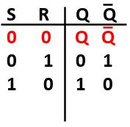
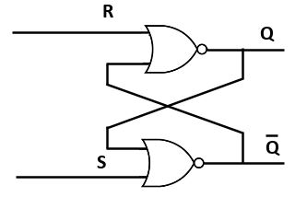
SR Latch - Implementation of Memory
Two inputs: S (Set) and R (Reset)
Two outputs: Q and Not Q (opposites)
SR Latches work because of feedback, notice how outputs from one NOR gate are driving outputs of the other.
0 0 state - “holds the current data”
0 1 state - reset, writes a 0 to data
1 0 state - set writes a 1 to data

Slide 36
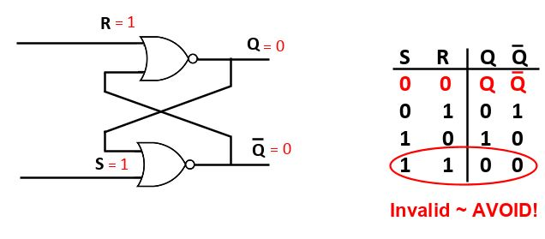
SR Latch - Implementation of Memory
But what happens when S=1 and R=1?

Slide 37
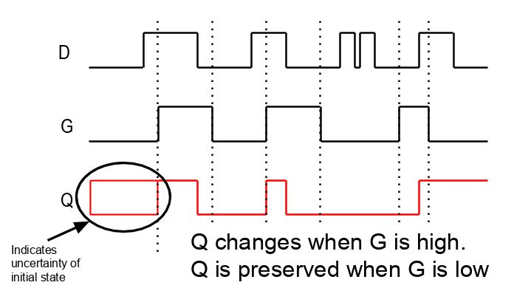
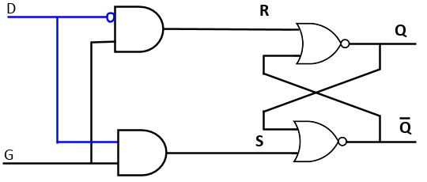
D-Latch - Another way to implement Memory
Two signals being fed in: the Data and a Gating Signal
State of the output changes while G is 1
When G is 0, no set or reset: SR latch in state 0 0, so value is held

Slide 38
Clocks
Periodic pulse. Switches from 0 to 1 periodically (equal intervals)
We can determine this interval, but it stays constant once set.
This will be useful when we do operations with different propagation delays

Slide 39
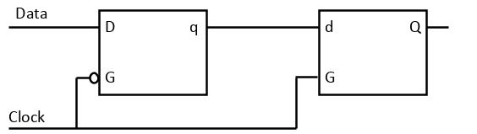
D-Flip Flop
2 D Latches chained together
2 signals being fed in: the Data and the Clock
State of the output changes while clock is changing state
Can be Rising-Edge Triggered OR Falling-Edge Triggered

Slide 40
D Latch vs. D Flip-Flop
Clk
1
2
Latch is level-sensitive
  Stores D when Clk=1 (Boxes)
Flip-flop is edge triggered
  Stores D when Clk changes from 0 to 1 (Rising Edge, dotted lines)
D
3
4
4
5
6
D Latch
7
8
D flip-flop
9
10

Slide 41
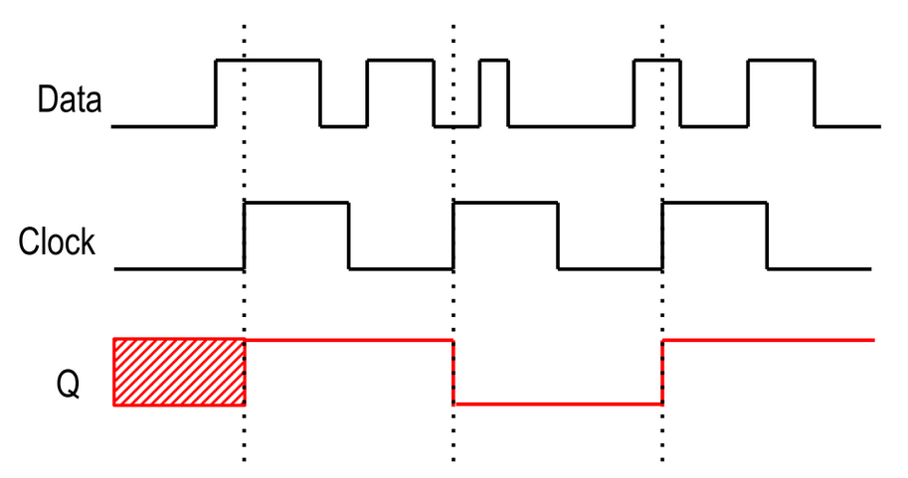
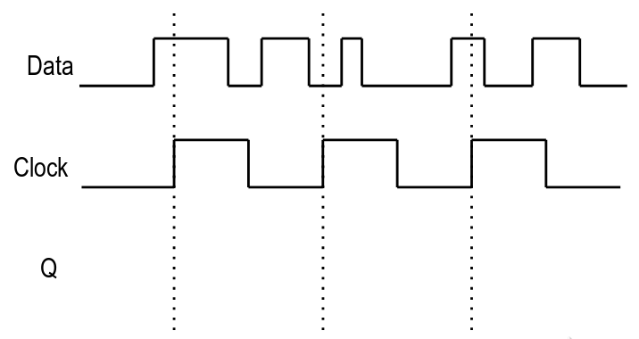
Problem 5: Timing Diagram for Rising-Edge FF
What does the output signal Q look like for a rising-edge flip-flop?

Slide 42
Finite-State Machine Definition
Describes desired behavior of sequential circuit.
  Like Boolean equations for combinational behavior.
FSM consists of:
  Set of inputs & outputs
    These are digital logic: bits, wires, numbers
  Set of states
    Each specifies output values
    One is the Initial state, Ex: “Off”
  Set of transitions
    Transition: <State, Input Value, Next State>
Notes:
‹#›

Slide 43
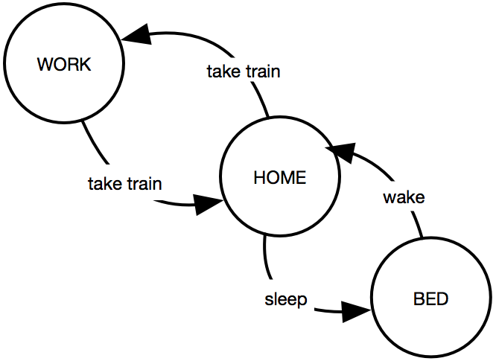
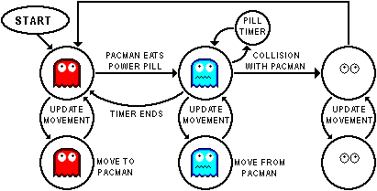
FSM Representations
We often draw FSM graphically as a state diagram
Can also use state table or textual languages
Notes:
‹#›

Slide 44
How To Capture Desired Behavior as FSM
List states
  Give meaningful names, show initial state
  Optionally add some transitions if they help
Create transitions
  For each state, define all possible transitions leaving that state.
    Make a transition for every possible input value.
Refine the FSM
  Execute the FSM mentally and make any needed improvements.

Slide 45
Capturing Sequential Circuit Behavior as FSM
Output: x
Example: Toggle x every clock cycle
States: “Lo” (x=0), and “Hi” (x=1)
Transition from on rising clock edge (clk^)
Arrow points to initial state
x=0
clk^
x=1
Lo
Hi
clk^
cycle 1
cycle 2
cycle 3
cycle 4
How to depict multi-bit or other info in a timing diagram
clk
state
Lo
Hi
Lo
Hi
Output: x
Notes:
‹#›

Slide 46
FSM Example: Three Cycles High System
Off
x=0
On1
x=1
Repeat 0, 1, 1, 1...
  For one clock cycle each
FSM
  Four states: 0, first 1, second 1, third 1
  Transition on rising clock edge to next state
On3
x=1
On2
x=1
clk
State
Off
On1
On2
On3
Off
On1
On2
On3
Off
Output x
Notes:
‹#›

Slide 47
FSM Simplification: Rising Clock Edges Implicit
In this course, assume every transition is on the clock edge.
What if we wanted a transition without a rising edge?
  Such asynchronous FSMs are less common, but are a more advanced topic
In this course, only consider synchronous FSMs.
x=0
clk^
x=1
x=0
x=1
Lo
Hi
Lo
Hi
clk^
Note: These are now unconditional transitions
Notes:
‹#›

Slide 48
Three-Cycles High System with Button Input
Off
x=0
b
Same 4 states
Wait in “Off” while b is 0
When b is 1, go to On1
  Sets x=1
  Then go to On2, On3, Off again
x=1 for 3 cycles
On1
x=1
b’
On3
x=1
On2
x=1
b’ is how we denote NOT b
clk
b
State
Off
Off
Off
Off
Off
On1
On2
On3
Off
x
Notes:
‹#›

Slide 49
FSM: Moore vs. Mealy Machines
Moore Machine
  Output function based on current state P(S) only
Mealy Machine
  Output function based on current state and current input P(S, I)
Question: which generally has more states?
Notes:
‹#›

Slide 50
Problem 6a: Design a Mealy Machine
Design a Mealy finite-state machine for a button-activated LED.
The light should remain lit while a button B is constantly pressed, or blink every third cycle while the button is not pressed. Assume the timer does not reset when the button is pressed.
State 0
(Start)
State 1
State 2
If B==0, L=1
If B==1, L=1
If B==0, L=0
If B==1, L=1
If B==0, L=0
If B==1, L=1

Slide 51
Problem 6b: Design a Moore Machine
Design a Moore finite-state machine for a button-activated LED.
The light should remain lit while a button B is constantly pressed, or blink every third cycle while the button is not pressed. Assume the timer does not reset when the button is pressed.
B’ | B
State 1 (Low B)
B’
State 2 (Low B)
State 0
(Start)
B’
B
L=0
L=0
B’
L=1
B
State 1 (High B)
State 2 (High B)
B | B’
B
L=1
L=1

Slide 52
Problem 7a: FSM Table
Design a finite state machine which solves the following problem and fill out the following table.
There is one input, I, and one output, O. O is high if the last 4 inputs on I were 1010 (the rightmost 0 is the most recent input bit).
Current State # | Next State when I = 0 | Next State when I = 1 | Output O (0/1)
000 (no bits) 000 001 0
001 (rec’vd 1) 010 001 0
010 (...10) 000 011 0
011 (...101) 100 001 0
100 (...1010) 000 011 1

Slide 53
Problem 7b: FSM Diagram
Design a finite state machine which solves the following problem and fill out the following tables. There is one input, I, and one output, O. O is high if the last 4 inputs on I were 1010 (the rightmost 0 is the most recent input bit).
b. Now, create your diagram following the table we just made.
I
I’
I’
State 1
(...1)
I’
State 2
(...10)
State 0
(Start)
I
O=0
O=0
O=0
I’
I
I
State 4
(1010)
I’
State 3
(...101)
O=1
I
O=0

Slide 54

FSM Example: Secure Car Key
Many new car keys include tiny computer chip
When key turned, car’s computer (under engine hood) requests identifier from key
Key transmits identifier
Else, computer doesn’t start car
FSM
Wait until computer requests ID (a=1)
Transmit ID (in this case, 1 1 0 1)
Inputs: a; Outputs: r
Wait
r=0
a
a
’
K1
K2
K3
K4
r=1
r=1
r=0
r=1
Notes:
‹#›

Slide 55
FSM Example: Secure Car Key
Nice feature of FSM
Can evaluate output behavior for different input sequence
Timing diagrams show states and output values for different input waveforms
Inputs:
a
O
utputs:
r
W
ait
r=0
a
a
’
K1
K2
K3
K4
r=1
r=1
r=0
r=1
Q: Determine states and r value for given input waveform:
clk
clk
I
Inputs
Inputs
a
a
a
e
State
St
Wait
Wait
K1
K2
K3
K4
Wait
Wait
State
W
ait
W
ait
K1
K2
K3
K4
W
ait
K1
O
Output
Outputs
r
r
Notes:
‹#›

Slide 56
FSM Capture Example: Code Detector
Unlock door (u=1) only when buttons pressed in sequence:
start, then red, blue, green, red
Input from each button: s, r, g, b
Also, output a indicates that some colored button pressed
Capture as FSM
  List states
Some transitions included
Start
Red
Green
Blue
u
s
Code Detector
Door unlocked
r
g
b
a
Inputs:
s
,
r
b
,a
,g,
W
ait
f
or sta
r
t
b
utton
Outputs:
u
W
ait
u=0
s
s'
Sta
r
t
W
ait
f
or first colored button
u=0
ar
ab
ag
ar
Red1
Blue
Green
Red2
u=0
u=0
u=0
u=1
Notes:
‹#›

Slide 57
FSM Capture Example: Code Detector
Capture as FSM
  List states
  Create transitions
Start
Red
Green
Blue
u
s
Code Detector
Door unlocked
r
g
b
a
Inputs:
s
,
r
,g,
b
,a
W
ait
f
or sta
r
t
b
utton
Outputs:
u
W
ait
u=0
s
s'
ar'
Sta
r
t
W
ait
f
or first colored button
u=0
a'
ar
ab
ag
ar
Red1
Blue
Green
Red2
u=0
u=0
u=0
u=1
Notes:
‹#›

Slide 58
FSM Capture Example: Code Detector
Start
Red
Green
Blue
u
Capture as FSM
  List states
  Create transitions
    Repeat for remaining states
  Refine FSM
    Mentally execute
    Works for normal sequence
    Check unusual cases
    All colored buttons pressed
      Door opens!
      Change conditions: other buttons NOT pressed also
s
Code Detector
Door unlocked
r
g
b
a
Inputs:
s
,
r
b
,a
,g,
Outputs:
u
W
ait
u=0
s
s'
ar'
ab'
ag'
ar'
Sta
r
t
a'
u=0
ar
ab
ag
ar
Red1
Blue
Green
Red2
a'
a'
a'
u=0
u=0
u=0
u=1
Notes:
‹#›

Slide 59
EECS 370
Lab 5: Digital Logic

